Slide 1

COMP122(SEC 006)-INTRODUCTION TO DATABASE GROUP PROJECT
Healthcare Management System Design

Slide 2
AGENDA
BACKGROUND
4 PHASES OF DATABASE DESIGN I)DATA REQUIREMENTS PHASE II)CONCEPTUAL DATA MODELING PHASE III)LOGICAL DATABASE DESIGN PHASE IV)PHYSICAL DATABASE DESIGN PHASE
CHALLENGES
CONCLUSIN
Q&A

Slide 3
Background
1. Problems in the Market:
Data Fragmentation: Patient data is often scattered across multiple systems, leading to incomplete patient profiles and potential misdiagnoses.
Inefficient Data Retrieval: Legacy systems often lack the speed and efficiency needed for real-time data retrieval, causing delays in patient care.
2. Purpose of the Healthcare Management System Database:
Centralized Data Storage: To consolidate patient data in one central system, ensuring a comprehensive patient profile.
3. Target Audience:
Healthcare Providers: Hospitals, clinics, and private practices that require efficient data management systems.
Medical Researchers: Professionals seeking a consolidated data source for medical research and studies.
4. Benefits to Users:
Quick Data Access: Users can quickly access and update patient data, improving efficiency in patient care.
5. Types of Data Stored:
Patient Profiles: Personal details, medical history, allergies, and more.
Medical Records: Diagnosis, treatment plans, medication, lab results, and medical imaging data.
Billing Information: Insurance details, billing history, and payment records.
Appointment Schedules: Patient appointments, doctor schedules, and operation theater bookings.
6. Benefits:
Scalability: The system can handle the growing volume of patient data, ensuring it remains efficient as healthcare institutions expand.

Slide 4
Database Design Process
DATABASE REQUIREMENTS PHASE
CONCEPTUAL DATA MODELING PHASE
LOGICAL DATABASE DESIGN
PHYSICAL DATABASE DESIGN

Slide 5
DATABASE REQUIREMENTS PHASE
1. Requirements Elicitation:
Doing Research About the Topic: We study and gather information about healthcare systems
Looking at Tasks: We see what jobs the new system should do. For example, it should save patient details and show medical records.
Checking Current System: If there's already a system, we look at it. We find out what's good and what needs to be better.
Getting Feedback: We ask users what they want. They can tell us their ideas and problems.
2. Requirements Specification:
What It Should Do: We write down all the tasks our system will do. Like saving patient names, showing medical history, and making bills.
What Data We Save: We decide what information to keep. This includes names, health details, and payment info.
How Fast It Should Be: We want our system to be quick. When someone asks for information, it should show up fast.
Keeping Data Safe: Patient data is private. We make sure only the right people can see it. And we follow rules to keep data safe.
Planning for the Future: Our system should work even if we have more patients or doctors. We plan so it can grow and change.
Writing Everything Down: We make a list of everything we decide. This list helps us in the next steps.

Slide 6
CONCEPTUAL DATA MODELING PHASE
Conceptual Data Modeling Phase:
1. Drawing the Basics:
We make a simple sketch of our database. It's like drawing a basic picture of our dream house.
2. Connecting the Main Parts:
We think about the main things in our hospital, like patients and doctors. We show how they are linked with lines.
3. Getting Feedback:
We show our drawing to each group members and discuss it . If it looks good or if we need to change something we discussed it.

Slide 7
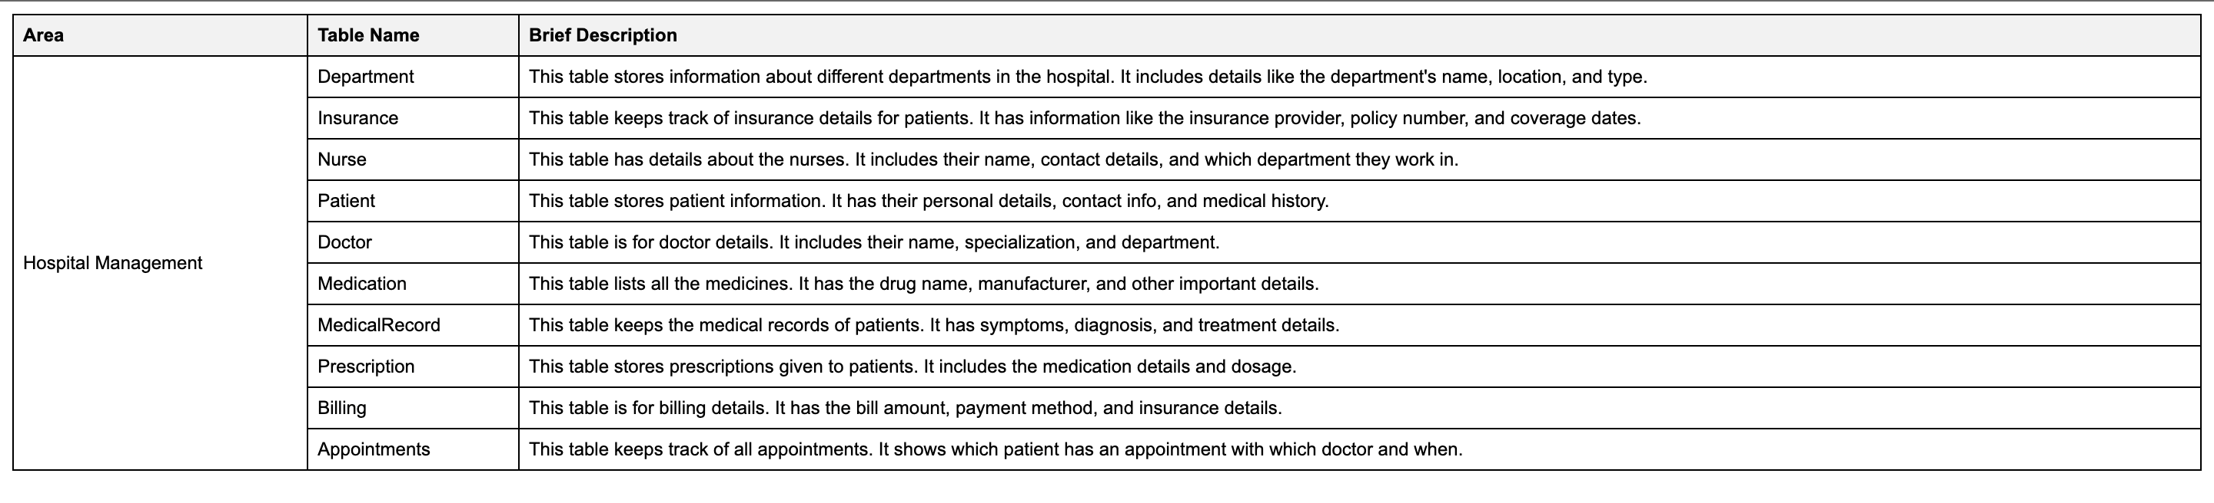
Overview of The Tables

Slide 8
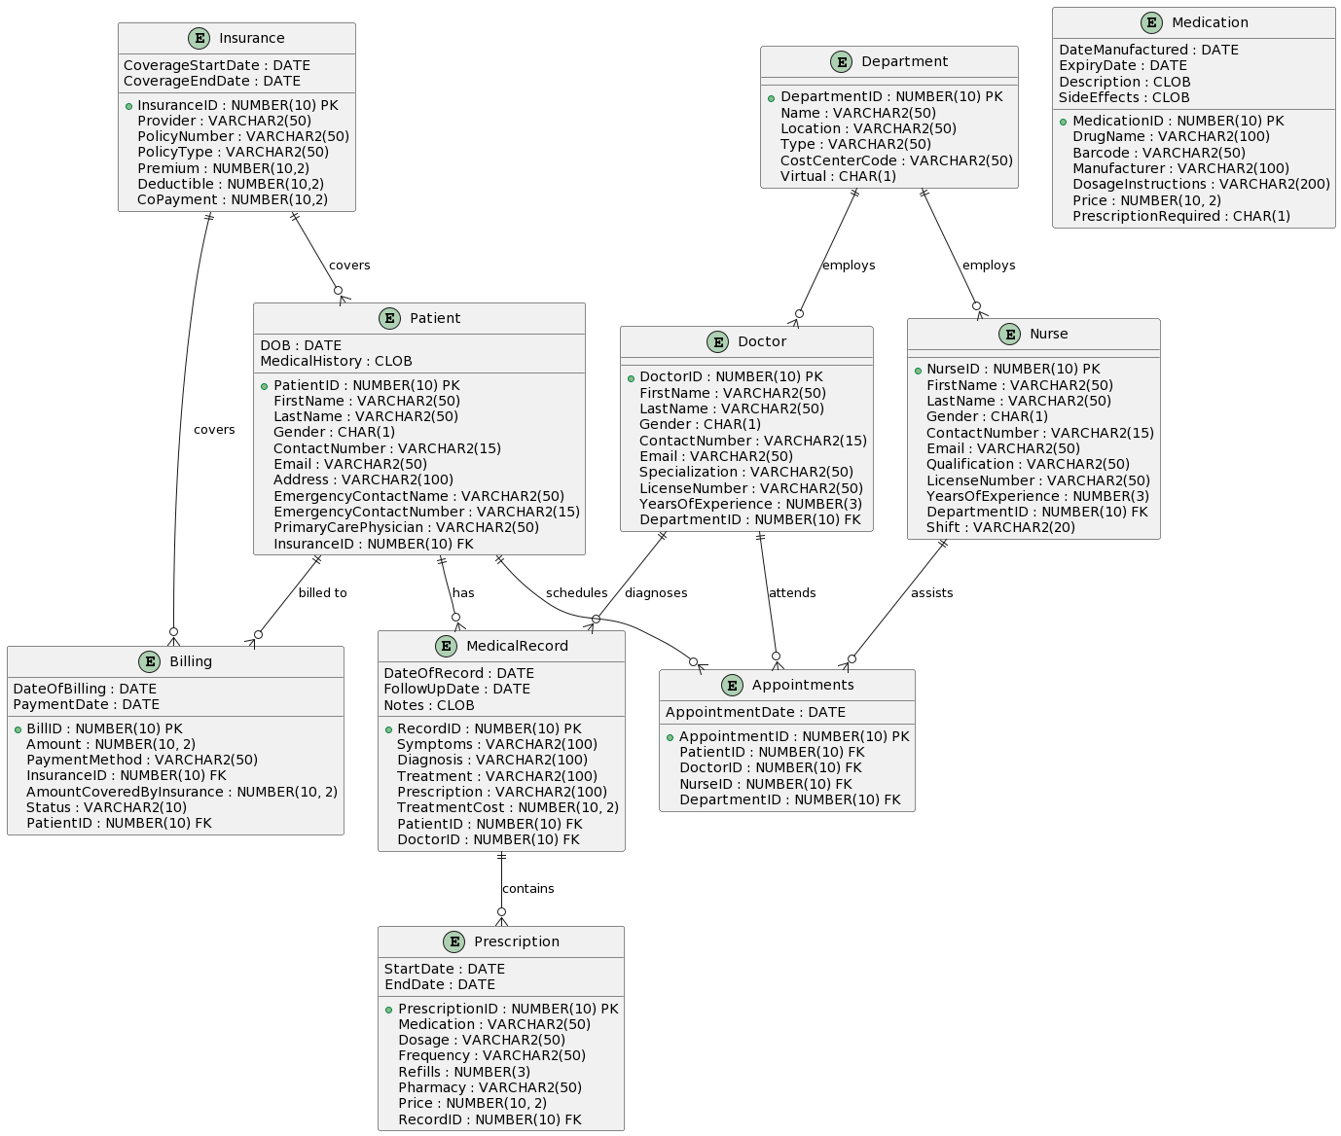
Entity Relationship Diagram (ERD)

Slide 9
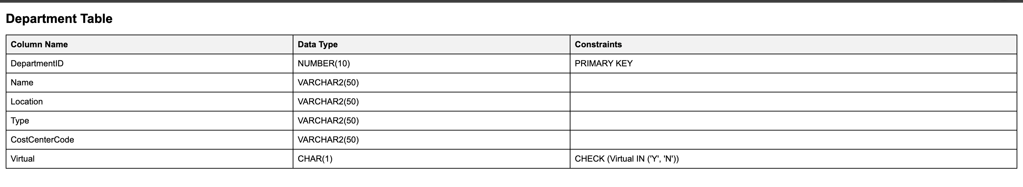
Details of all 10 Tables
Overview:
Table Name: Department
Description: Contains details about hospital departments. The 'Virtual' column can only have values 'Y' or 'N'.
Relation: One-to-Many with Nurse, Doctor, and Appointments tables (One department can have multiple nurses, doctors, and appointments).

Slide 10
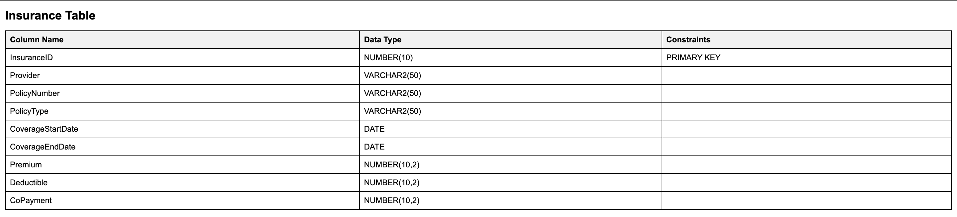
Table Name: Insurance Description: Stores insurance details for patients. Relation: One-to-Many with Patient and Billing tables (One insurance can be linked to multiple patients and bills).

Slide 11
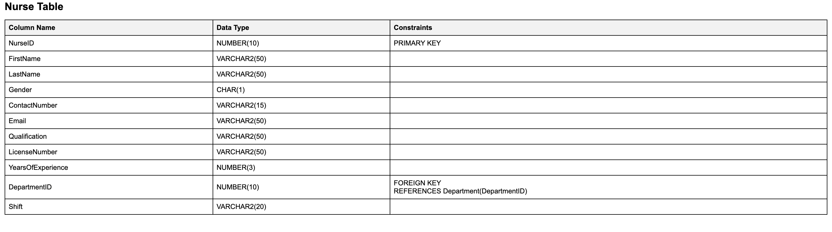
Table Name: Nurse Description: Holds information about nurses in the hospital. Relation: Many-to-One with Department (Multiple nurses can belong to one department). One-to-Many with Appointments (One nurse can have multiple appointments).

Slide 12
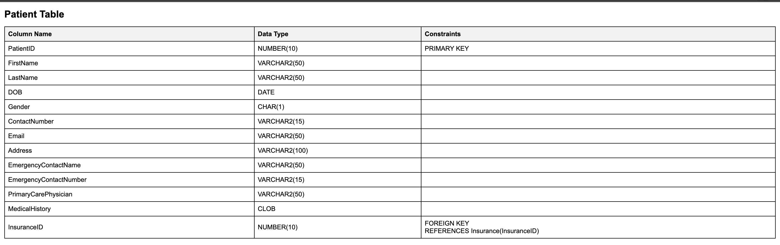
Table Name: Patient Description: Contains personal and contact details of patients. Relation: Many-to-One with Insurance (Multiple patients can have one insurance). One-to-Many with MedicalRecord, Billing, and Appointments (One patient can have multiple medical records, bills, and appointments).

Slide 13
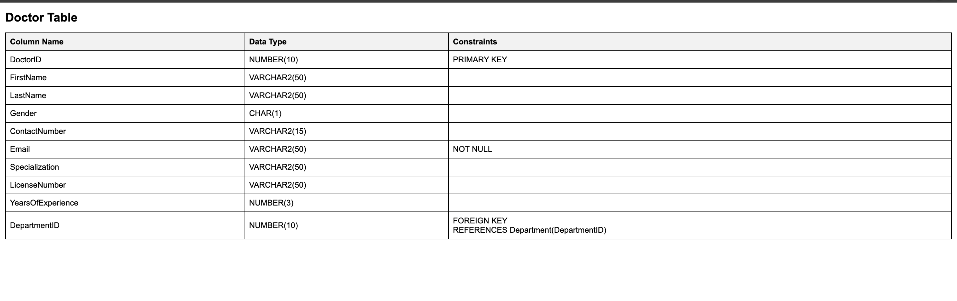
Table Name: Doctor Description: Stores details about doctors. Relation: Many-to-One with Department (Multiple doctors can belong to one department). One-to-Many with MedicalRecord and Appointments (One doctor can have multiple medical records and appointments).

Slide 14
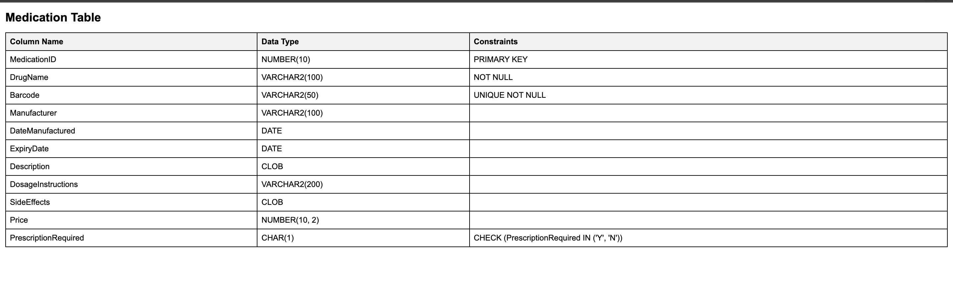
Table Name: Medication Description: Lists medicines with details. The 'Barcode' column is unique, and 'PrescriptionRequired' can only have values 'Y' or 'N'. Relation: One-to-Many with Prescription (One medication can be prescribed multiple times).

Slide 15
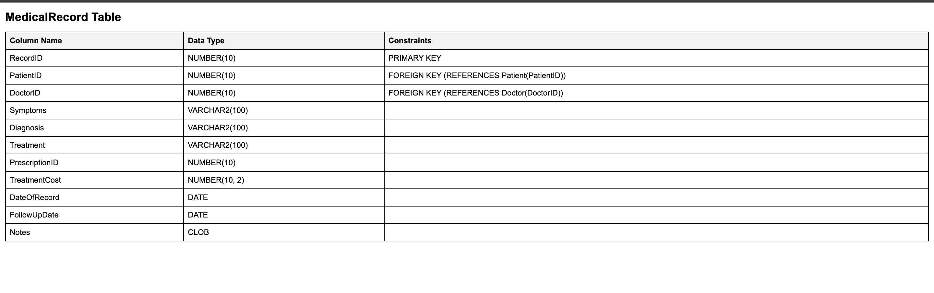
Table Name: MedicalRecord Description: Keeps records of patients' medical details. Relation: Many-to-One with Patient and Doctor (Multiple medical records can belong to one patient or be created by one doctor). One-to-One with Prescription (One medical record can have one prescription).

Slide 16
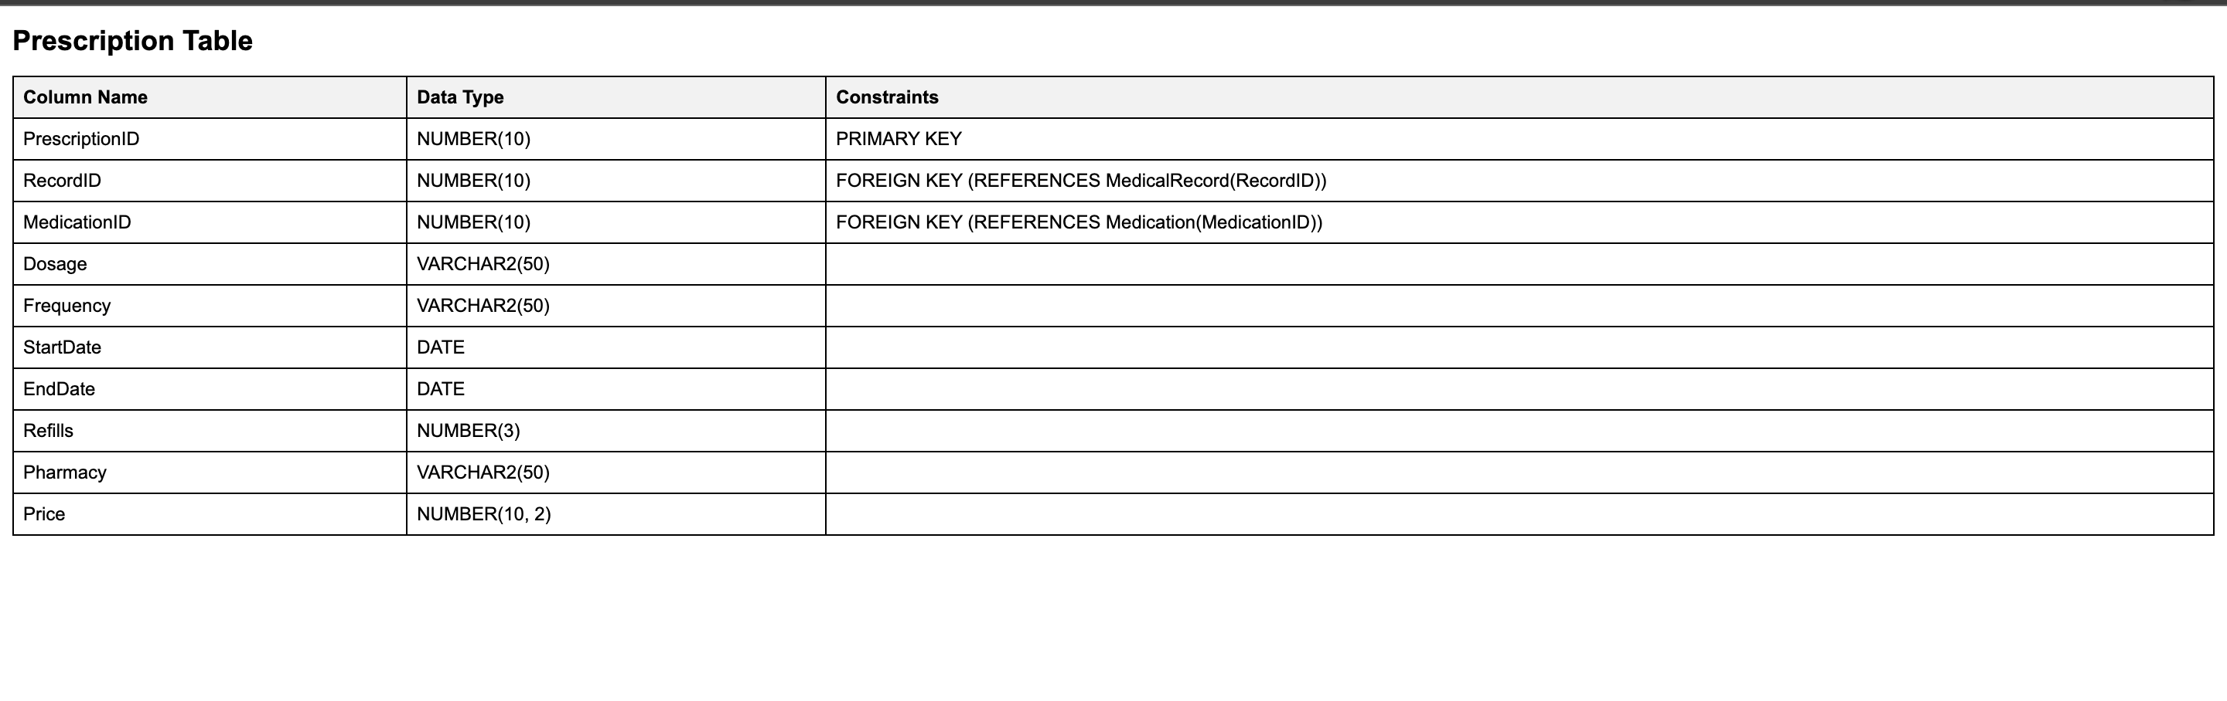
Table Name: Prescription Description: Contains details of prescriptions given to patients. Relation: Many-to-One with MedicalRecord and Medication (Multiple prescriptions can belong to one medical record or be for one medication).

Slide 17
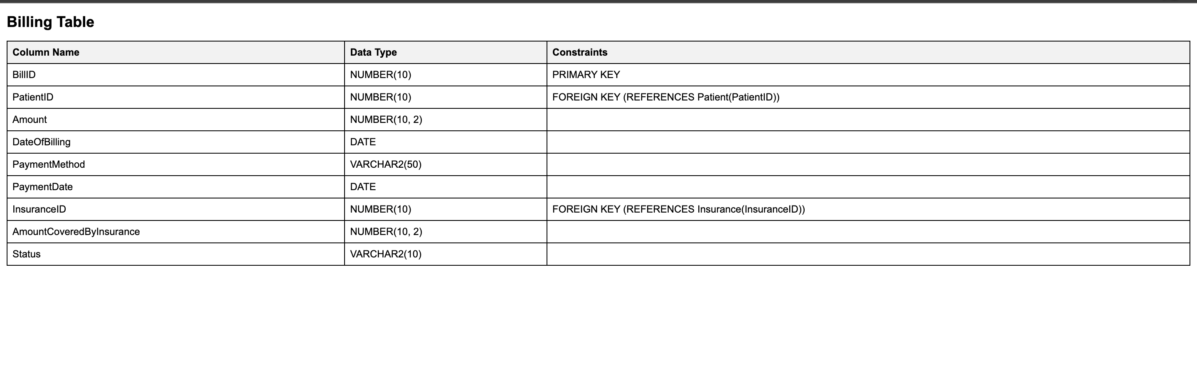
Table Name: Billing Description: Manages billing details for patients. Relation: Many-to-One with Patient and Insurance (Multiple bills can belong to one patient or be covered by one insurance).

Slide 18
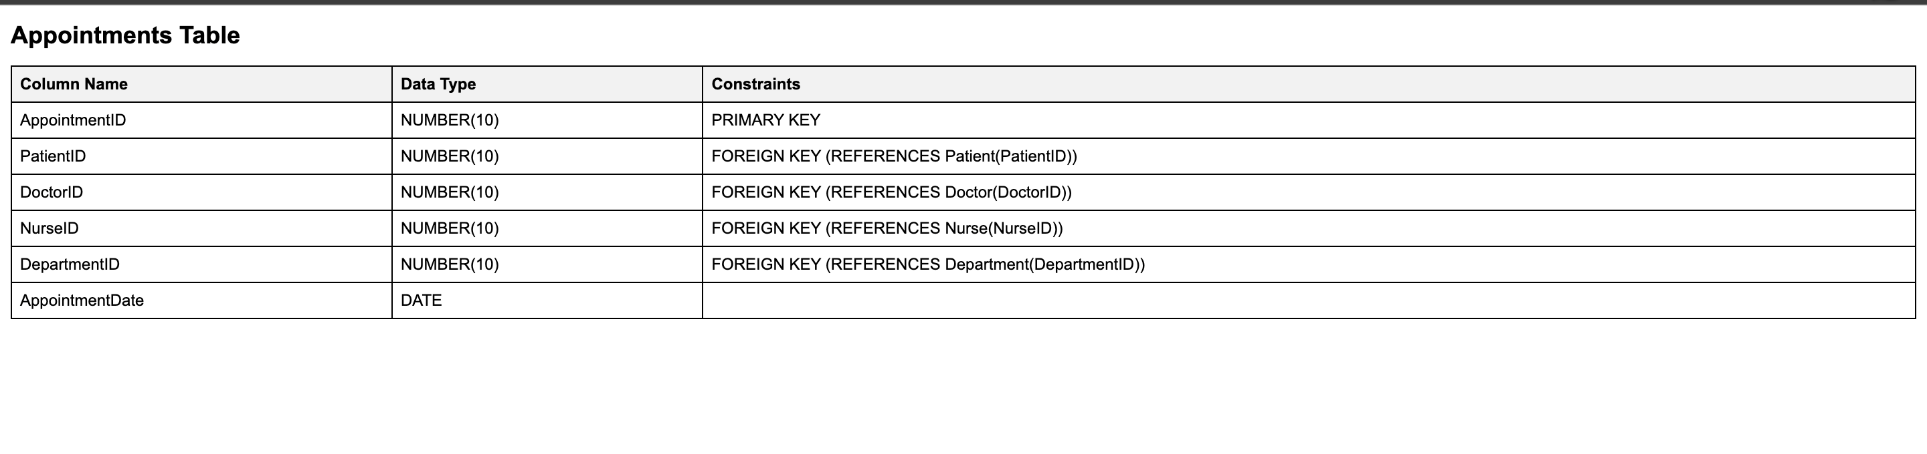
Table Name: Appointments Description: Tracks scheduled appointments in the hospital. Relation: Many-to-One with Patient, Doctor, Nurse (optional), and Department (Multiple appointments can belong to one patient, doctor, nurse, or department).

Slide 19
Challenges
First building a database from scratch. -It was a challenging process for all group members conjure up an more comprehensive database for the healthcare management system. -We search websites for design database such as Reddit , Youtube
It was challenging Creating the tables, because each table has Constraints and same attributes stored in different tables because of this it was essential to create the classes in order , inserting values as well.

Slide 20

Conclusion
In conclusion, we were able to create a healthcare management system comprising of crucial records such patient, doctor, prescription etc. We were able to demonstrate a clear understanding of the relationships between the tables and display various complex queries(single row functions, joins, operators) as illustrated in the document.

Slide 21

References
National Center for Biotechnology Information. (n.d.). Health Databases and Health Database Organizations: Uses, Benefits, and Concerns. NCBI Bookshelf. Retrieved August 10, 2023, fromHealth Databases and Health Database Organizations: Uses, Benefits, and Concerns - Health Data in the Information Age - NCBI Bookshelf (nih.gov) Stanford University. (n.d.). Databases in Healthcare. Stanford University. Retrieved August 10, 2023, from ⁵
Unknown (stanford.edu)
Casteel, J. (2015). Oracle 12c: SQL (3rd ed.). Cengage Learning. ISBN-13: 978-1305251038. ISBN-10: 1305251032.

